Slide 1
Employee Data
analysis using Excel
Name:
Nabeelah Parveen . I
Register no:
312209037
Department:
B.com General
Collage:
Chevalier T. Thomas Elizabeth college for women | Arts and Science collage

Slide 2
Employee Performance Analysis using Excel
Project Title

Slide 3
Agenda
01
Problem Statement
02
Project Overview
End Users
03
04
Our Solution and Proposition
Dataset Description
05
Modelling Approach
06
Results and Discussion
07
Conclusion
08

Slide 4
Problem Statement
Employee Performance Analysis helps identify strengths and areas for improvement, enabling informed decisions on promotions, training, and overall workforce productivity. It ensures alignment with company goals and enhances employee development.

Slide 5
Project Overview
Employee Performance Analysis is the process of evaluating and assessing an employee's work performance over a specific period. It involves measuring various aspects such as productivity, quality of work, efficiency, adherence to deadlines, and overall contribution to the organization's goals. The analysis helps identify strengths, areas for improvement, and potential training needs, ultimately guiding decisions related to promotions, rewards, and development plans.

Slide 6
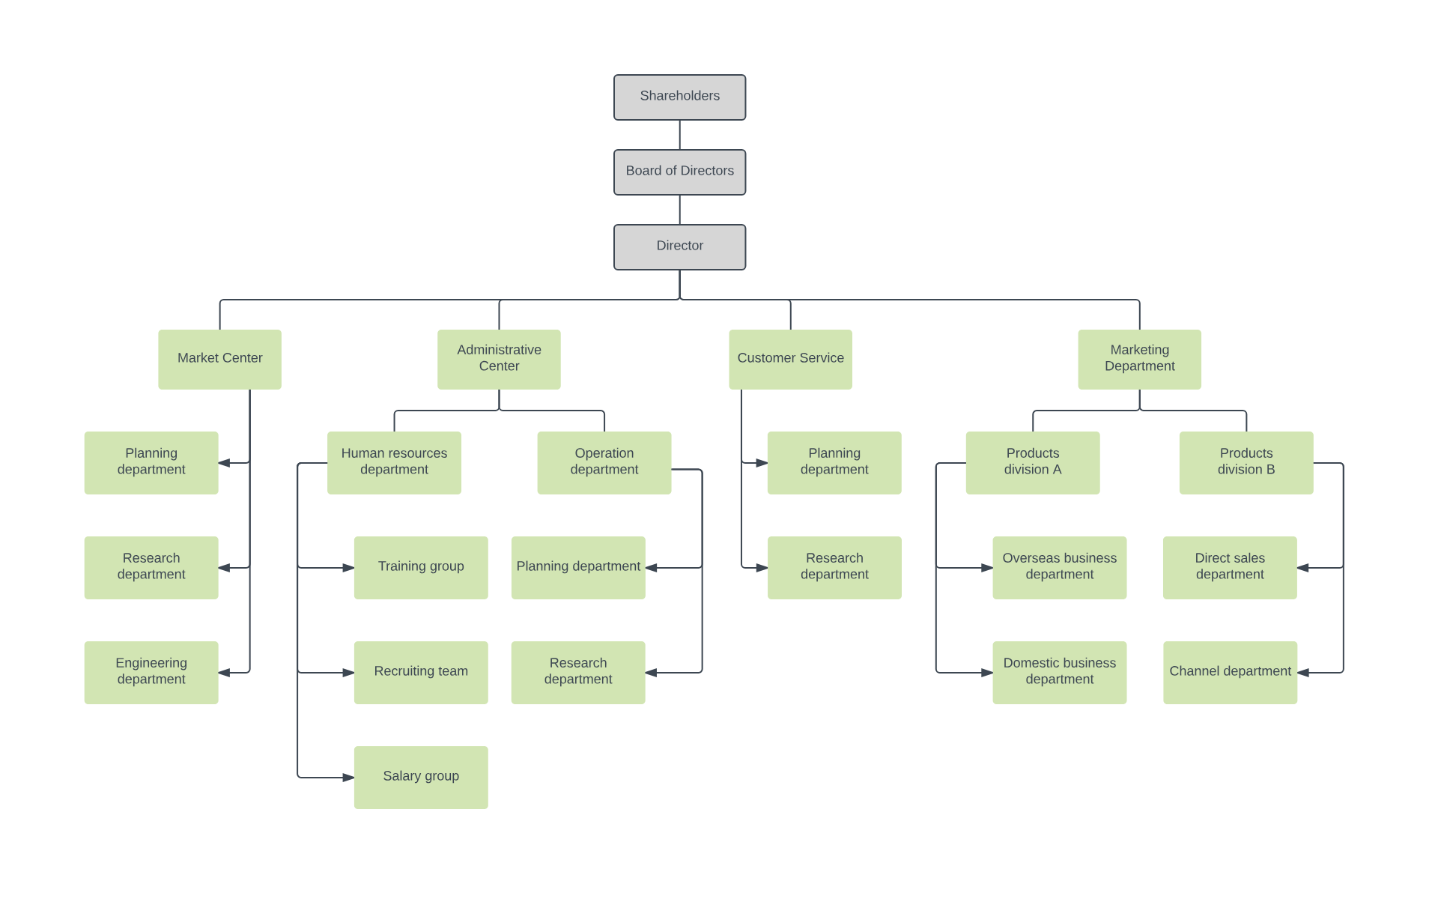
Who are the end users
The end users of Employee Performance Analysis are HR managers, team leaders, and senior management, who use it for managing talent, guiding team performance, and making strategic decisions.

Slide 7
Our solutions and its
value proposition
01
02
03
Conditional Formatting:
Conditional Formatting in Google Sheets is used to automatically change the appearance of cells based on specific criteria or conditions.
Filtering
Filtering in Google Sheets is used to display only the rows that meet specific criteria, making it easier to analyze and manage data.Filtering in Google Sheets is used to display only the rows that meet specific criteria, making it easier to analyze and manage data.
Formula
Formulas in Google Sheets are used to perform calculations, analyze data, and automate tasks within spreadsheets.
Notes:
v

Slide 8
04
05
Pivot Table
A Pivot Table in Google Sheets is used to summarize, analyze, and organize large sets of data for easy reporting and insights.
Graph
Graphs in Google Sheets help visualize data trends and patterns, making complex information easier to understand and analyze
Notes:
v

Slide 9
Data set Description
Employee dataset i have downloaded from “EDUNET” Dashboard
It has “25 Features”, and i have picked 9 Features from that for Calculating Employee data analysis.
List of features which i have collected from Data Excel sheet.
Employee Id : Numerical Values
Employee Type: Text Type
First name: Text Type
Employee classification type: Text Type
Last name: Text Type
Gender Code: Text Type
Business Until: Text Type
Performance score: Text Type
Employee status: Text Type
Current Employee Rating: Numerical Values
Performance Level: Text Type

Slide 10
The “wow” in our solution
I have used a “Formula” to remove empty columns.
IFS(Z8>=5,"VERY HIGH",Z8>=4,"HIGH",Z8>=3,"MED",TRUE,"LOW")

Slide 11
Modelling
Data Collection | Feature Selection | Data Clearing
This data is collected from naan mudhalvan edunet dashboard | It has “25 Features”, and i have picked 9 Features from that for Calculating Employee data analysis. | I have used Conditional formatting method to remove empty columns

Slide 12
Pivot Table | Employee Performance Chart | Performance Level
I have added the following data in the Pivot table: - Added business unit data in Rows. - Added performance level data in Columns. - Employee names in Values. - Added Gender, Employee type and Employee Status in Filters/Slicers. | - Business Unit - Performance Level - Employee First name | - Very High - Hiigh - Medium - Low

Slide 13
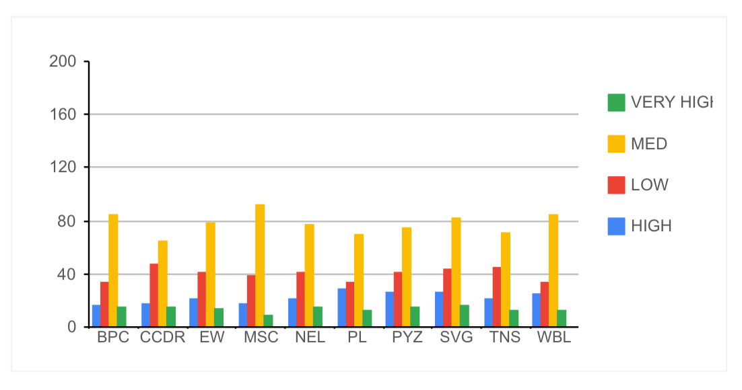
Result
Employee Data Analysis Chart Result

Slide 14
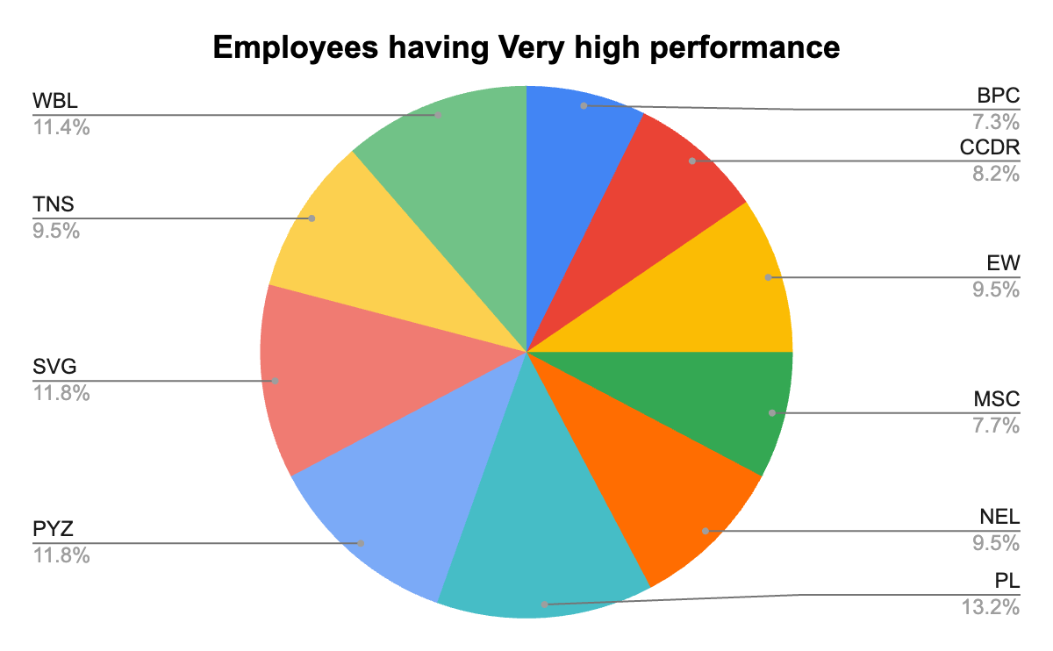
Male and Female active full time employees

Slide 15
Conclusion
By using conditional formatting, formulas, and a Pivot table in Google Sheets, I efficiently streamlined the data and extracted meaningful insights, leading to a clear and concise Employee Performance Analysis.

